Slide 1
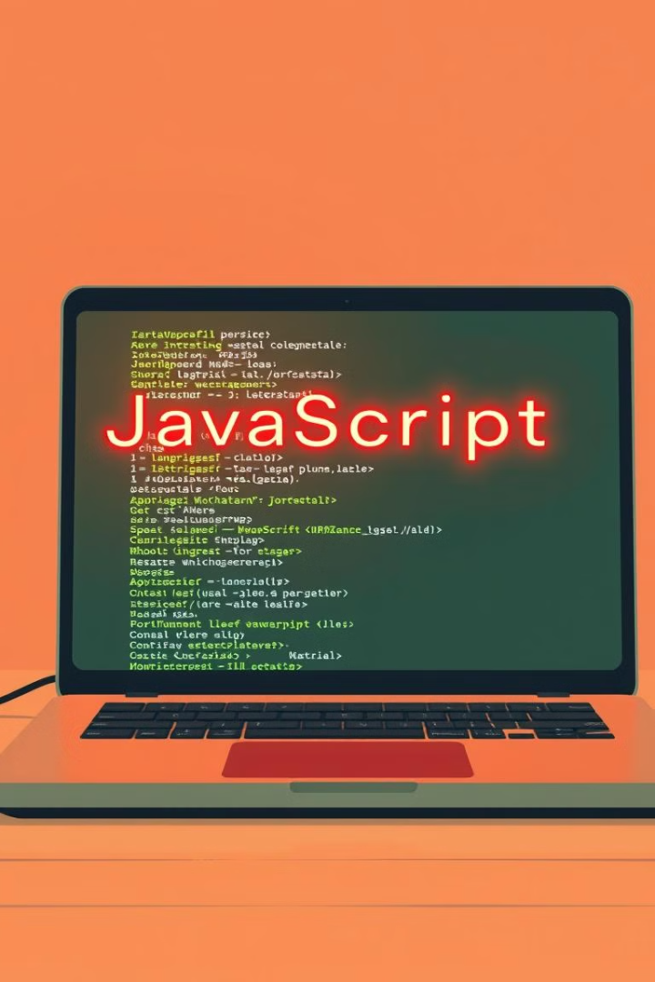

Introduction to JavaScript
This presentation covers the basics of JavaScript. We'll explore what it is and what sets it apart. Let's understand how it's used in modern web development.
by muniba khan

Slide 2
What is JavaScript?
Interactive Web Pages
Browser-Side Execution
Dynamic Content
JavaScript is a programming language. It enhances web pages by making them interactive.
It runs inside web browsers. This allows animations and dynamic content.
With javascript you can create forms and add dynamic content.
document.getElementById("myText").style.color = "red";

Slide 3
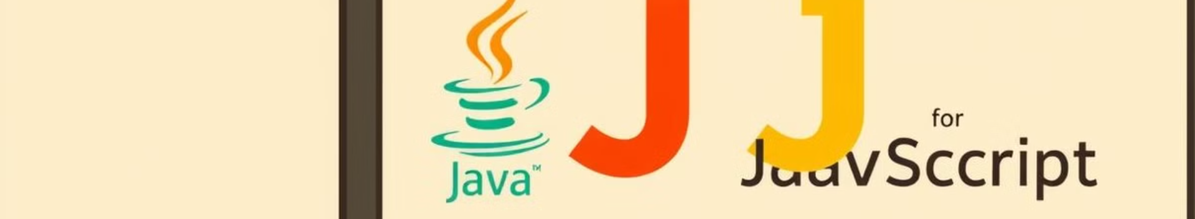
Java vs. JavaScript
Feature
Java
JavaScript
Type
Programming Language
Scripting Language
Runs On
Computer (JVM)
Browser
Use Case
Apps, Games
Websites, Web Apps
Compilation
Compiled
Interpreted

Slide 4
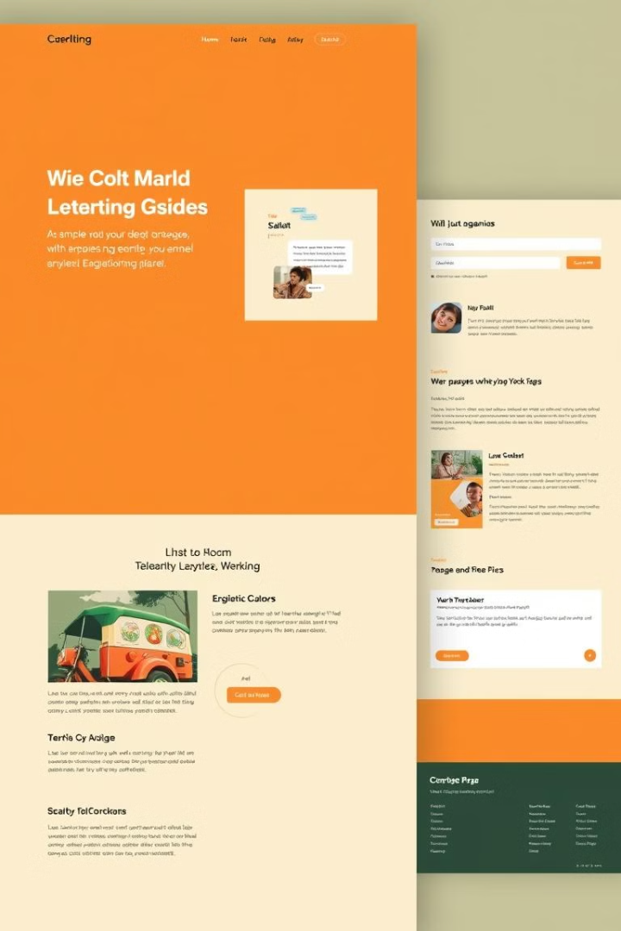
Websites vs. Web Applications
1
Websites
Websites are a collection of static pages. Examples include blogs and news sites.
2
Web Applications
Web applications are interactive. They perform tasks like on Facebook or Gmail.

Slide 5
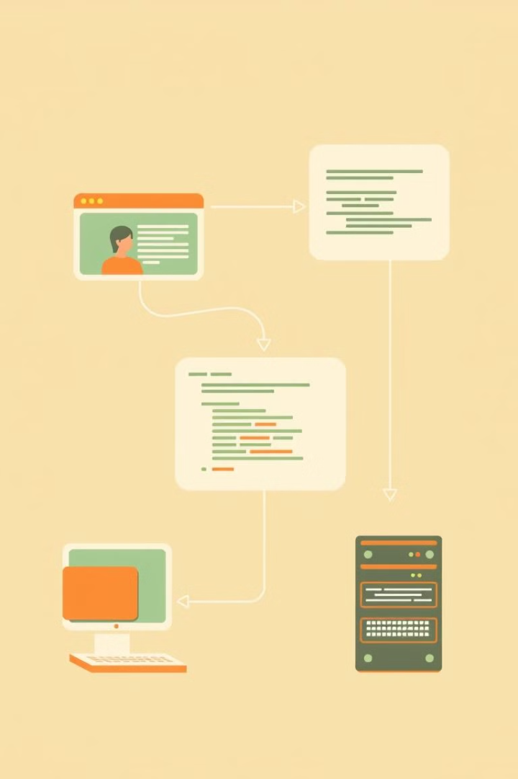
Client-Side vs. Server-Side Scripting
Client-Side
Runs on the user’s browser. This is fast. An example is JavaScript.
Server-Side
Runs on the web server. This can be slower. Examples are PHP and Python.

Slide 6
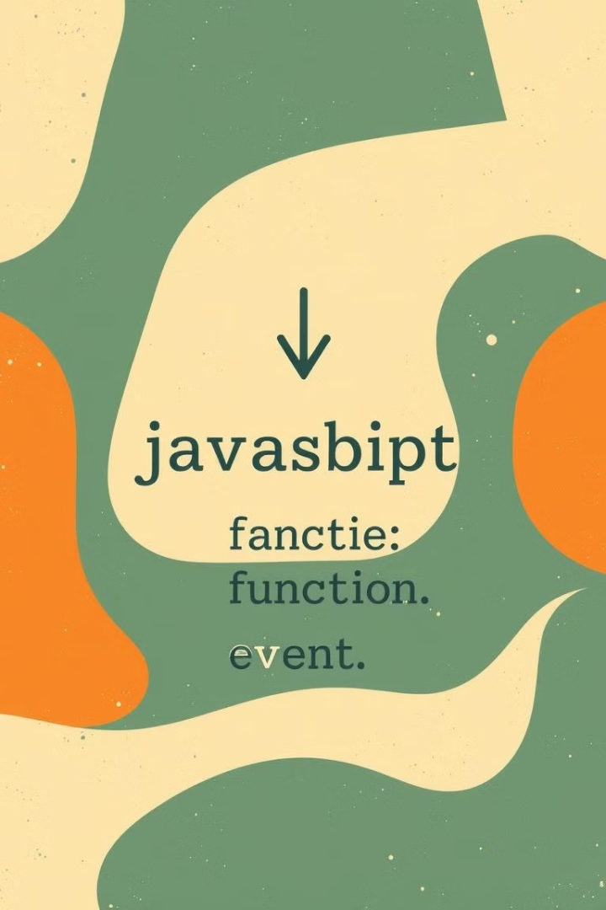

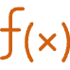

Basic JavaScript Concepts
Variables
Functions
Events
Variables store values. For example,
Functions perform actions. For example,
Events respond to user actions. For example,
let name = "Ali";
function greet() { alert("Hello!"); }
document.getElementById("btn").onclick = greet;

Slide 7




Example - Interactive Button
HTML
JavaScript
Result
When the button is clicked, text changes.
<button onclick="changeText()">Click Me</button>
<p id="demo">Hello!</p>
<script>
function changeText() {
document.getElementById("demo").innerHTML = "You clicked!";
}
</script>

Slide 8
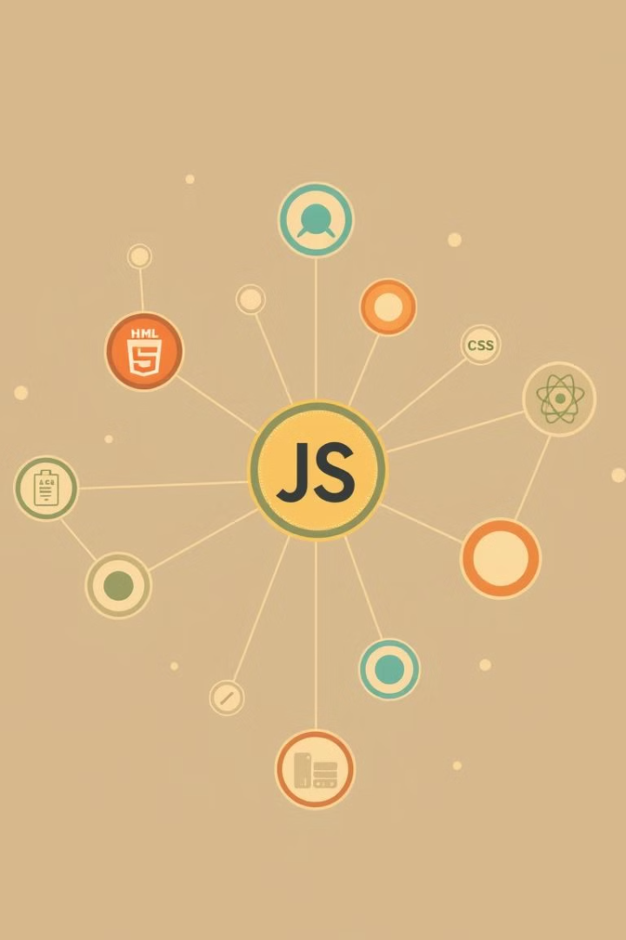
Key JavaScript Takeaways
1
Interactivity
JavaScript makes websites interactive. It enhances user experience.
2
Client-Side
It works on the client-side. This reduces server load.
3
Web Apps
Used in web apps like Facebook and Gmail. It is essential for dynamic content.
4
Modern Development
Learning JavaScript helps in modern web development. This is a valuable skill.

Slide 9
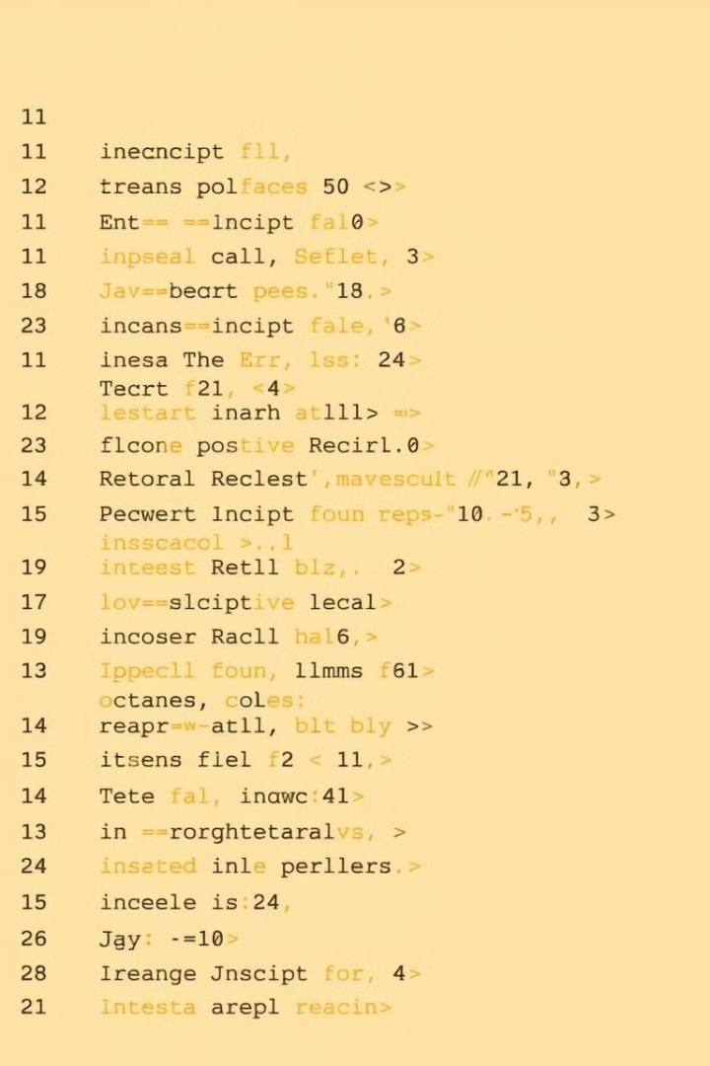
Conclusion
JavaScript enhances website interactivity. It operates on the client-side. It's vital for web application development.
Learning JavaScript is crucial for modern web development. It's used in web apps like Facebook and Gmail.

